Slide 1

Damage Detection of Offshore Concrete
Zhaohua Li
2022/8/4
Notes:
陈老师，您好，这是关于研究计划的汇报，题目为海上混凝土的损伤检测

Slide 2
Outline
01
Introduction
02
Literature review
03
Plan
Notes:
本次汇报将从以下三个方面进行阐述。

Slide 3
01
Introduction
Notes:
首先是研究背景

Slide 4






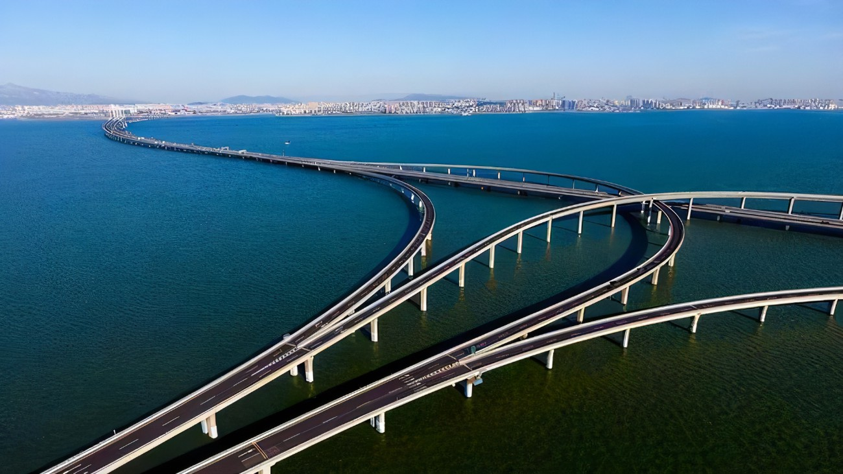
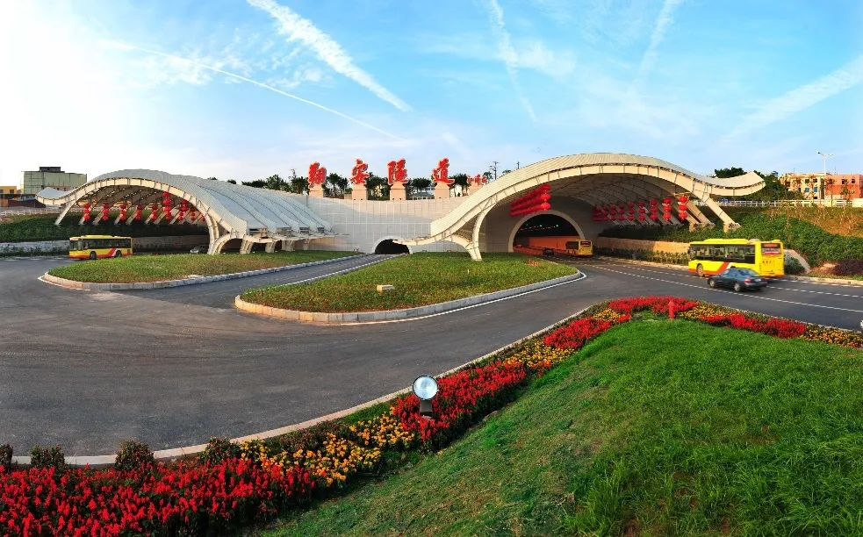
1 Introduction
Large marine area
Rapid development of marine engineering
Concrete structures are widely used because of the easy availability of the materials, low cost, and good stability and durability.
Damage assessment of reinforced concrete structures using a model-based nonlinear approach – A comprehensive review[J]. Construction & Building Materials, 2018, Vol. 192: 846-865.
Notes:
众所周知，海洋面积广大，海洋工程飞速发展。而混凝土结构由于容易获得、造价低廉、并且具有良好的稳定性和耐久性，被广泛使用在海洋工程中。

Slide 5
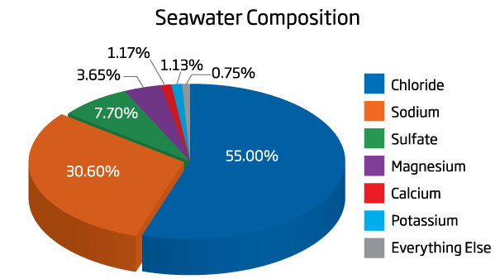
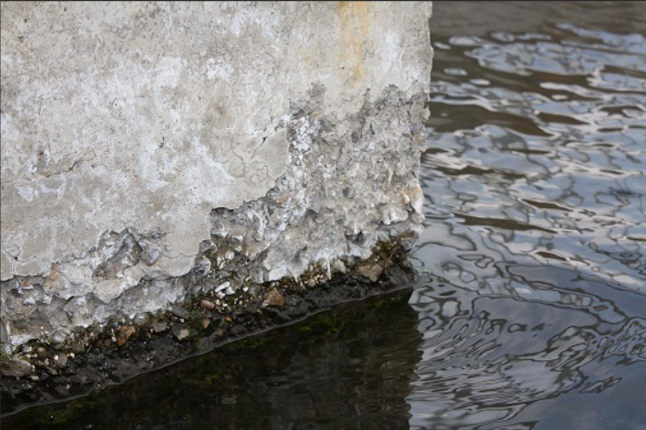
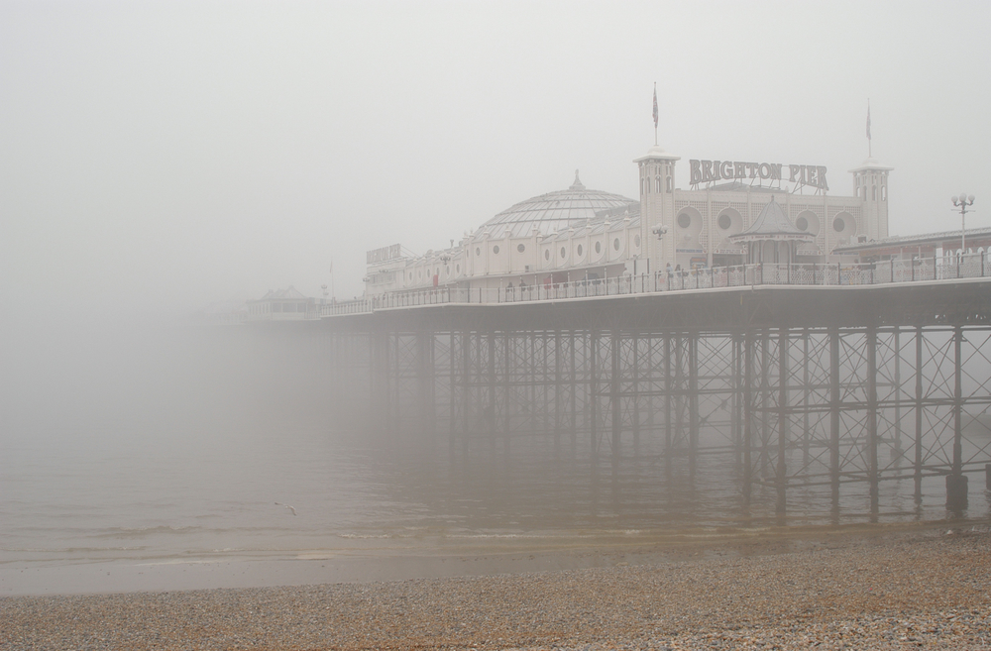
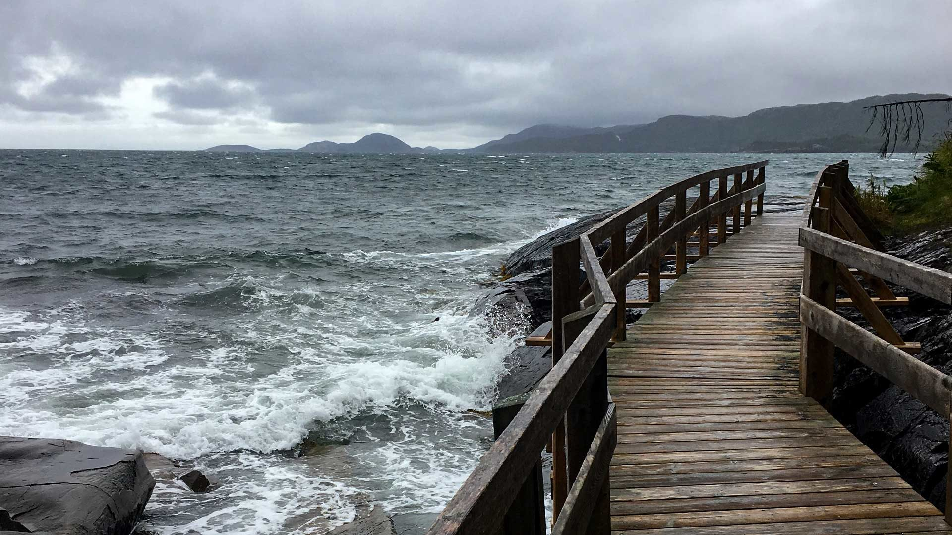
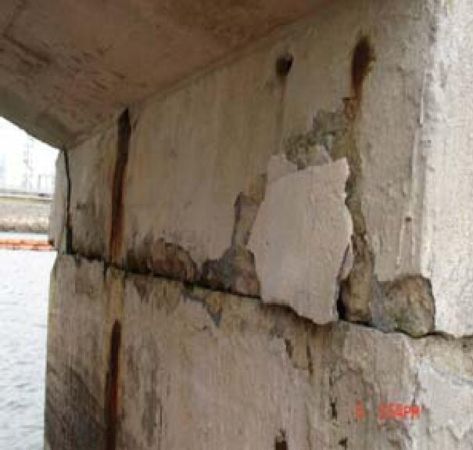
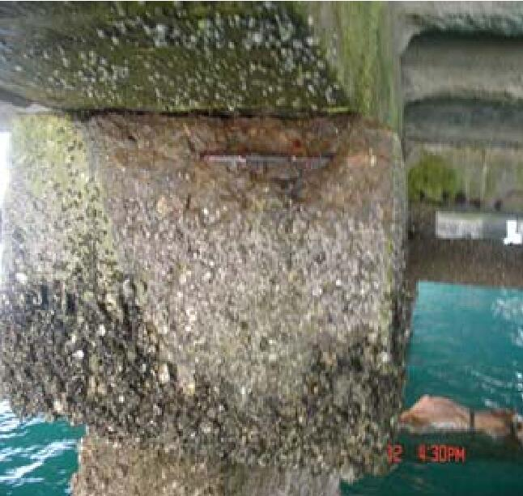
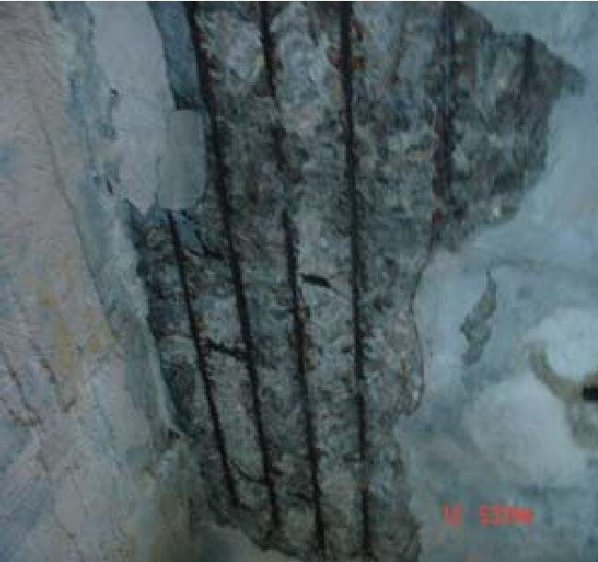
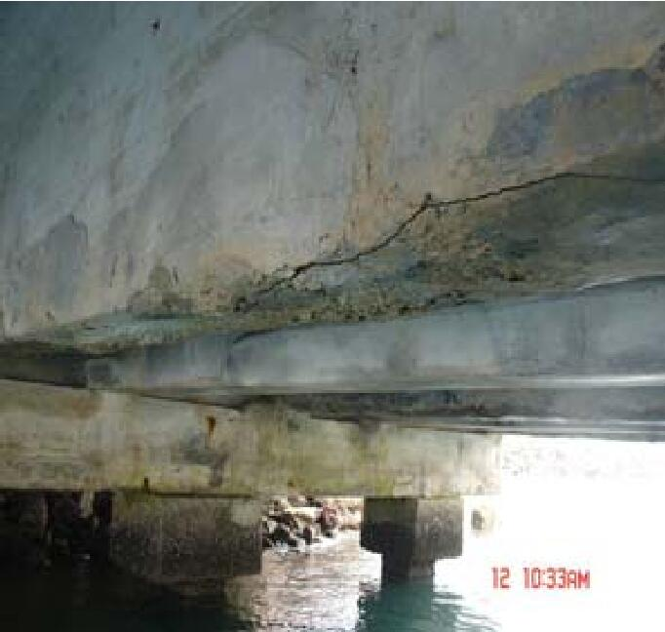
1 Introduction
Harsh marine environment
Complex mechanism of damage
Complex damage mechanism, with form of cracks, leaks and exfoliation.
Durability deterioration of concrete under marine environment from material to structure: A critical review[J]. Journal of Building Engineering, 2021,Vol.35: 102074.
The effects of cyclic fluid pressure on time-dependent corrosion behaviour of offshore concrete caused by chloride ions[J]. Mechanics of Time-Dependent Materials, 2022.
Notes:
但由于海洋环境复杂，海水化学因子侵蚀、冻融循环、盐雾、海浪撞击等多种因素的共同作用，使得混凝土结构损伤问题十分复杂。

Slide 6
1 Introduction
Crack formation
Crack propagation
Crack penetration
It is very important to detect cracks in offshore concrete structures.
Durability deterioration of concrete under marine environment from material to structure: A critical review[J]. Journal of Building Engineering, 2021,Vol.35: 102074.
The effects of cyclic fluid pressure on time-dependent corrosion behaviour of offshore concrete caused by chloride ions[J]. Mechanics of Time-Dependent Materials, 2022.
Notes:
虽然损伤成因复杂，但传统损伤力学认为，对于混凝土而言，其损伤演变形式主要表现为微裂纹的萌生、扩展直到最后裂缝贯通失去稳定。因此，为了确保海工混凝土结构服役的安全性，对于其结构内部裂纹的监测非常重要，因此本研究拟以针对海上混凝土结构的裂纹损伤检测为目的。

Slide 7
02
Literature review
Notes:
接下来是文献综述

Slide 8

2 Literature Review
Less waste
Less downtime
Accident prevention
Identify areas of concern before failure
Comprehensive testing
Increased product reliability
NDT
(Non-destructive testing)
Non-destructive testing (NDT) is a testing and analysis technique to evaluate the situation of a structure without causing damage to the original part.
Audio–Visual methods
Stress-wave methods
Electrical or electro-magnetic methods
Miscellaneous methods
Nondestructive test methods for concrete bridges: A review[J], 2016, vol. 107:58-86.
Notes:
目前，无损检测技术是损伤检测的主流方法，用于评估结构的状况，而不对原部件造成损害。它具有减少样品浪费、降低停工时间、预防事故等优点。接下来将概述混凝土无损检测的常用技术。

Slide 9
2.1 Literature Review- Visual & Audio Methods
Visual method
Advantages
Easy to operate.
Low cost.
Disadvantages
Time-consuming.
Requires the subjective judgement.
No detailed and quantitative information available.
No real-time monitoring.
Limited monitoring situation.
Limited monitoring cases.
Audio method
Step 1:
Step 2:
Ringing
Hollow
Standard Practice for Measuring Delaminations in Concrete Bridge Decks by Sounding, Annual book of ASTM standards, vol. 04.03. Philadelphia: ASTM, 1987. p. 749-51.
A new non-contacting non-destructive testing method for defect detection in concrete[J]. NDT and E International, 2002,Vol.35(6): 399-406.
Notes:
首先是基于视听的传统检测方法，视觉方法是通过表面观察，判断结构表面是否有损伤。听觉方法一般是用金属物体如锤子等击打结构表面，当敲击有缺陷的区域时，会听到特有的空洞声，以此判断损伤位置。传统的视听方法虽然操作简单低成本，但是耗时费力，监测能力有限。

Slide 10
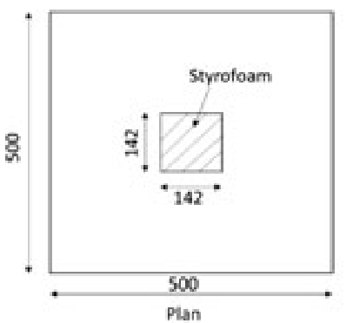
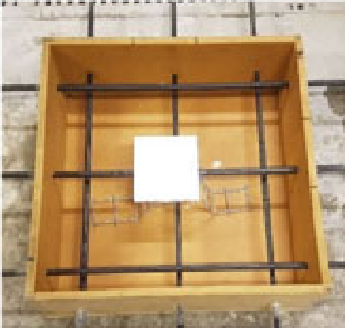
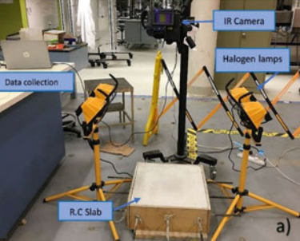
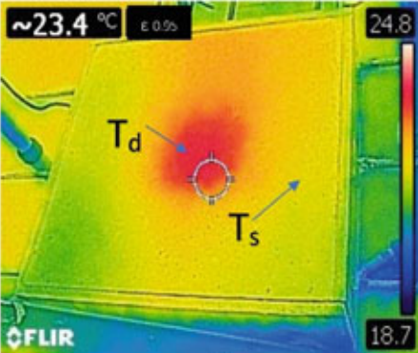
2.3 Literature Review- Infrared Thermography
Infrared thermography detecting diagram
Advantages
Remote use without direct coupling with structure/material.
Suitability for rapid assessment of large or high- rise buildings.
Real-time displaying of collected results.
Power control unit
Processing unit
Infrared camera
Halogen lamp
Halogen lamp
Disadvantages
Difficult to detect deep flaws.
Surface irregularities, boundary condition and atmospheric temperature influence the results.
Expensive equipment.
Variations in the test response with varying environmental conditions.
Experienced operator required.
Application of infrared thermography to the non-destructive testing of concrete and masonry bridges[J]. 2003, vol. 36(4): 265-275.
Active IR-applications in civil engineering[J]. Infrared Physics & Technology, 2002, vol. 43(3-5): 233-238.
Infrared thermography for detecting subsurface defects of concrete structures[J]. Lecture Notes in Civil Engineering, 2021, Vol. 101: 1165-1176.
Notes:
红外热成像法，它是依据热学进行检测的，如左图所示，当待测结构存在损伤时，损伤部位的热传导性能会发生改变，利用红外热像仪采集待检测结构的红外图像，通过处理，形成红外热像图，从而可以直观的判断出损伤。这种方法可实现非接触检测，对大型建筑物有较好的实用性，但难以检测深层内部损伤，表面的不规则性、环境温度等也会对检测结果造成影响。

Slide 11
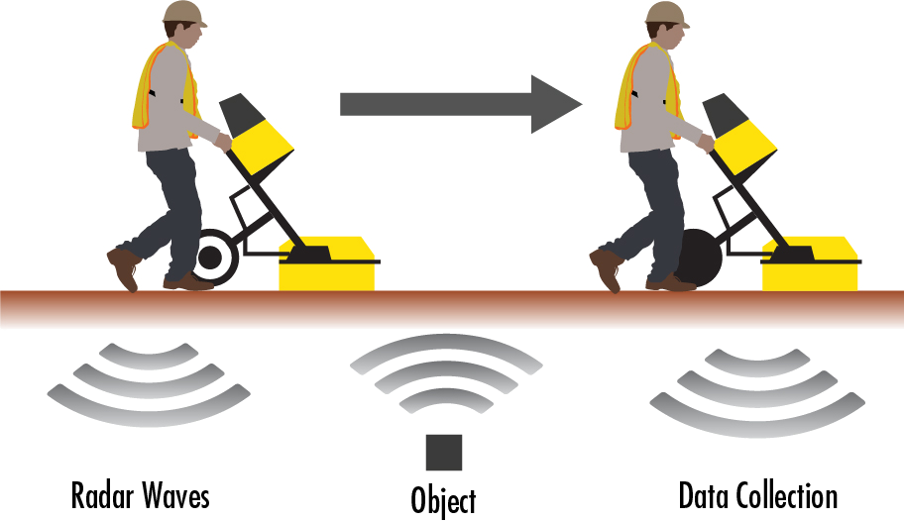
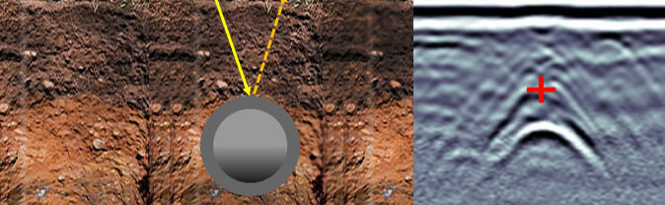
2.4 Literature Review- Ground-Penetrating Radar
Ground-Penetrating Radar
Advantages
Light and portable equipment.
No coupling medium.
Real-time continuous displaying of results.
Rapid investigations of large areas.
Disadvantages
Extreme cold conditions effects the GPR data.
Requirement for skilled specialist to interpret data from the system.
Expensive equipment.
Difficulty in detecting early-stage decay.
Limited depth of penetration of pulses from high-resolution antennas.
Recent Advancements in Non-Destructive Testing Techniques for Structural Health Monitoring[J]. Applied Sciences, 2021, vol.11 (2750): 2750.
Using Ground Penetrating Radar Methods to Investigate Reinforced Concrete Structures.[J]. Surveys in Geophysics, 2020, Vol. 41(3): 485-530.
Nondestructive test methods for concrete bridges: A review[J], 2016, vol. 107:58-86.
http://iovasia.com/ground-penetrating-radar/
Notes:
雷达法是依据电磁波进行检测的，如左图所示，电磁波从天线发出传入混凝土中，在传播过程中遇到损伤时发生反射，反射电磁波传回天线，传递给主机并对接收到的信息进行分析计算和成像处理，从而实现损伤检测。所用设备轻巧便携，可实时呈现探测图像，但该方法在极寒条件下获得信号会受到影响，也需要经验丰富的专业人员进行专业评判。

Slide 12

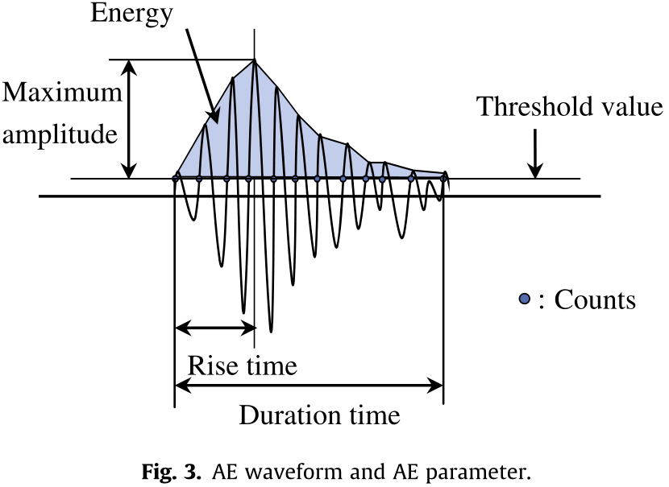
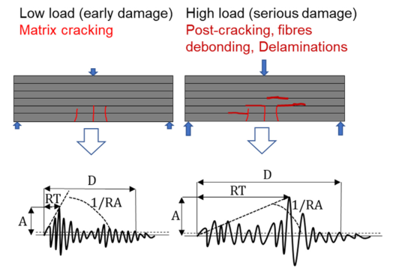
2.2 Literature Review- Acoustic Emission Test
AE detecting diagram
Advantages
No need for motivation.
Real time capability.
High sensitivity.
Assessment during real operational conditions.
Low cost.
Data acquisition
Signal processing
Electric signal
AE sensor
Disadvantages
Requirement for the flat surface of the structure.
Requirement for a couplant (gel or oil).
Inability to identify existing defects.
No repeatable experiments.
Vulnerable to environmental noise.
Contact measurement.
Crack
Evaluation for RC specimen damaged from rebar corrosion by acoustic emission technique[J]. Construction and Building Materials, 2014, Vol. 67: 157-164.
A review of acoustic emission as indicator of reinforcement effectiveness in concrete and cementitious composites.[J].Construction & Building Materials,2019,Vol.224: 198-205
Notes:
声发射技术是依据应力波的原理，如左图所示，当结构出现变形或者裂纹扩展时，所产生的瞬态能量会以弹性波的形式快速释放，并在材料中传播，引起被测结构表面的振动，耦合在结构上的传感器依据压电效应将振动转换成电压信号，经过仪器放大后传到主机并进行信号处理。该方法属于被动监测，无需主动激励信号，可以在结构运行期间实时监测，但存在对结构表面要求平整，需要耦合剂，不能重复实验等缺点。

Slide 13
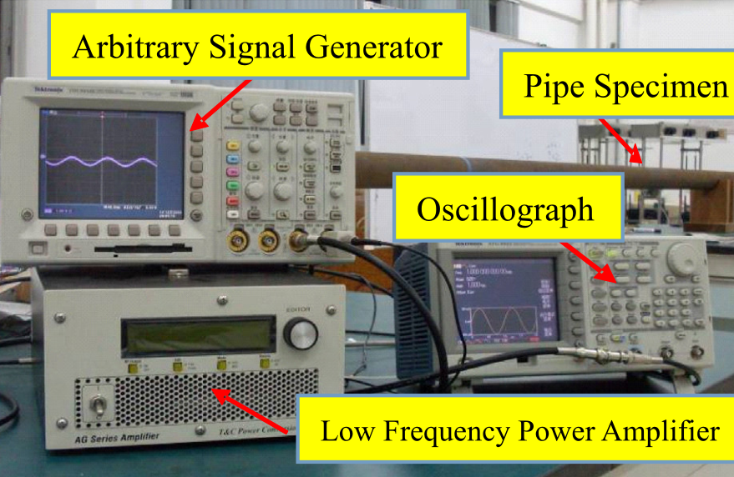
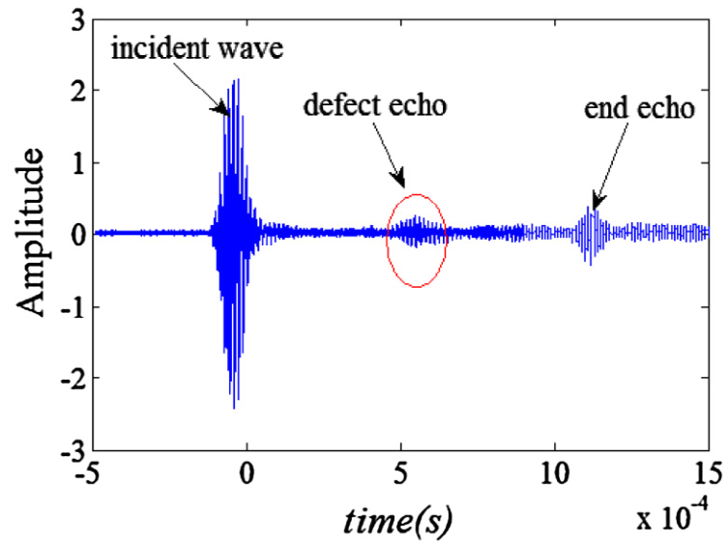
2.4 Literature Review - Ultrasonic Method
Ultrasonic Method
Advantages
High penetrating power.
Real time capability.
High sensitivity.
Usually only one surface needs to be accessible.
No-hazardous to operations or nearby personnel.
Signal generator
Oscilloscope
Trigger
Ultrasonic Receiver
Disadvantages
Surface must be accessible to transmit ultrasound.
A couplant (gel or oil) is needed to enable interference-free transfer the ultrasound.
Objects that have a rough surface or are very thin or not homogenous are difficult to inspect.
Some defects might remain undetected due to use of lower frequencies.
Exciting Ultrasonic
Measuring Ultrasonic
Detection of minor damage in structures with guided wave signals and nonlinear oscillator[J]. Measurement, 2018, Vol. 122: 532-544.
Nondestructive test methods for concrete bridges: A review[J], 2016, vol. 107: 58-86.
Notes:
超声检测技术也是依据应力波的原理，与声发射技术不同，超声检测技术通常被称为主动检测，如左图所示，超声波装置一般由发射换能器和接收换能器组成，发射换能器发射应力波，当结构存在损伤时，发射信号会与损伤相互作用，产生变化，然后带有损伤信息的信号传播至接收换能器接收，通过分析波形参数判断损伤。该方法的优点是超声波具有很强的穿透力，可以实时检测，对损伤具有较高的敏感性。但该方法要求表面平整，需要耦合剂以保证超声波的传播，对激发频率等具有较高的要求。

Slide 14
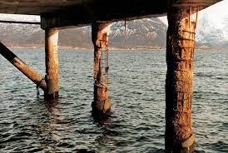
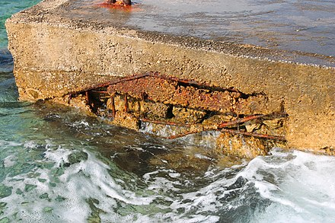
2.5 Literature Review - Ultrasonic Method
Excitation methods
Sensing methods
Advantages
High penetrating power.
No-hazardous to operations or nearby personnel.
Shock waves
Piezoelectric Patches
Disadvantages
A couplant (gel or oil) is needed to enable interference-free transfer the ultrasound.
Expensive transducer installation and cabling.
Transducers and cables are vulnerable to damage.
Sound source
Piezoelectric Ring
Service Environment
Impact laser
Detection laser
A Survey of Developments in Ultrasonic NDE of Concrete. [J]. IEEE Transactions on Ultrasonics, Ferroelectrics, and Frequency Control, 1994, vol.41(1): 140-143.
Damage detection sensitivity characterization of acousto-ultrasound-based structural health monitoring techniques. [J]. Structural Health Monitoring, 2016, vol.15(2): 143-161.
Demonstration of 25-Hz-inspection-speed laser remote sensing for internal concrete defects. [J]. Journal of Applied Remote Sensing, 2018, vol.12(1): 015009.
A new non-contacting non-destructive testing method for defect detection in concrete. [J]. NDT and E International, 2002, vol.35(6): 399-406.
14
Notes:
随着研究的深入，超声技术发展出了更多的激发方式与接收方式，如空气冲击波、声波、激光等激发方式，压电片、压电环、激光接收等接收方式，这些方式的区别只是信号的激发与接收方式的不同，波在结构中的传播规律没有改变，仍具有超声波检测的优点

Slide 15
2.5 Literature Review - Ultrasonic Method
Excitation methods
Sensing methods
Advantages
High penetrating power.
No-hazardous to operations or nearby personnel.
Shock waves
Piezoelectric Patches
Disadvantages
A couplant (gel or oil) is needed to enable interference-free transfer the ultrasound.
Expensive transducer installation and cabling.
Transducers and cables are vulnerable to damage.
Sound source
Piezoelectric Ring
Service Environment
Impact laser
Detection laser
A Survey of Developments in Ultrasonic NDE of Concrete. [J]. IEEE Transactions on Ultrasonics, Ferroelectrics, and Frequency Control, 1994, vol.41(1): 140-143.
Damage detection sensitivity characterization of acousto-ultrasound-based structural health monitoring techniques. [J]. Structural Health Monitoring, 2016, vol.15(2): 143-161.
Demonstration of 25-Hz-inspection-speed laser remote sensing for internal concrete defects. [J]. Journal of Applied Remote Sensing, 2018, vol.12(1): 015009.
A new non-contacting non-destructive testing method for defect detection in concrete. [J]. NDT and E International, 2002, vol.35(6): 399-406.
15
Notes:
但是基于压电片和压电环的接收方式，仍对结构的表面的平整性有较大的要求，需要使用耦合剂保证信号的传播，在恶劣环境下，检测装置安装困难，易于损坏

Slide 16
2.5 Literature Review - Ultrasonic Method
Excitation methods
Sensing methods
Advantages
High penetrating power.
No-hazardous to operations or nearby personnel.
Shock waves
Piezoelectric Patches
Disadvantages
A couplant (gel or oil) is needed to enable interference-free transfer the ultrasound.
Expensive transducer installation and cabling.
Transducers and cables are vulnerable to damage.
Sound source
Piezoelectric Ring
Service Environment
Impact laser
Detection laser
A Survey of Developments in Ultrasonic NDE of Concrete. [J]. IEEE Transactions on Ultrasonics, Ferroelectrics, and Frequency Control, 1994, vol.41(1): 140-143.
Damage detection sensitivity characterization of acousto-ultrasound-based structural health monitoring techniques. [J]. Structural Health Monitoring, 2016, vol.15(2): 143-161.
Demonstration of 25-Hz-inspection-speed laser remote sensing for internal concrete defects. [J]. Journal of Applied Remote Sensing, 2018, vol.12(1): 015009.
A new non-contacting non-destructive testing method for defect detection in concrete. [J]. NDT and E International, 2002, vol.35(6): 399-406.
16
Notes:
而海工混凝土的服役环境复杂，结构损伤形式多样，相较来说，基于激光激发和接收的超声检测无需与结构进行接触，针对海工混凝土的损伤检测来说是具有潜力的方式。

Slide 17
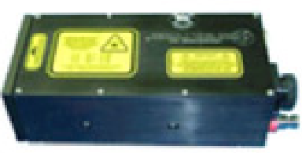
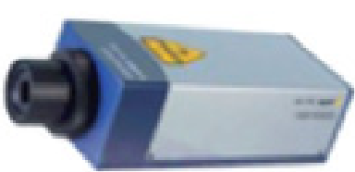
2.6 Literature Review - Laser Ultrasonic Method
Schematic diagram of the laser ultrasonic system
Excitation Unit
Control Unit
Laser
Transverse Stress
Thermoelastic effect
Receiver
Longitudinal stress
Trigger
Trigger
(power density<10⁶W/cm²)
Nd: Yag Laser
Galvanometer
Galvanometer
LDV
Laser
Excitation Unit
Sensing Unit
Transverse Stress
Ablation effect
Longitudinal stress
(power density>10⁷W/cm²)
Research progress of laser ultrasonic inspection of metal additive manufacturing components[J]. Chinese Journal of Lasers, 2022, 1-27.
Defect measurement using the laser ultrasonic technique based on power spectral density analysis and wavelet packet energy[J]. Microwave and Optical Technology Letters, 2021, Vol.63(8): 2079-2084.
Notes:
如左图所示，激光超声检测的原理是利用高能激光脉冲与物质表面的瞬时热作用，在固体表面产生热应力区，从而在物体表面产生应力波即超声波，超声波与损伤作用，然后携带被测构件的损伤信息被激光接收器接收，通过信号处理获取损伤信息。

Slide 18
2.6 Literature Review - Laser Ultrasonic Method
Schematic diagram of the laser ultrasonic system
Excitation Unit
Control Unit
Laser
Transverse Stress
Thermoelastic effect
Receiver
Longitudinal stress
Trigger
Trigger
(power density<10⁶W/cm²)
Nd: Yag Laser
Galvanometer
Galvanometer
LDV
Laser
Excitation Unit
Sensing Unit
Transverse Stress
Ablation effect
Longitudinal stress
(power density>10⁷W/cm²)
Research progress of laser ultrasonic inspection of metal additive manufacturing components[J]. Chinese Journal of Lasers, 2022, :1-27.
Research on Laser Ultrasonic Exciting Technology[J]. Nondestructive testing, 2005, Vol. 27(6): 286-287, 305.
Notes:
针对整个过程，首先激发超声波信号，从信号的激发机理来看，主要有热弹效应与热蚀效应。区别主要为激发功率不同，激发结果不同，热弹效应主要产生横向应力，对结构没有损害，烧蚀效应主要产生纵向应力，会让结构产生损伤，通常所说的激光超声指的是热弹效应。常用的激光发射器为Nd: YAG激光器。

Slide 19
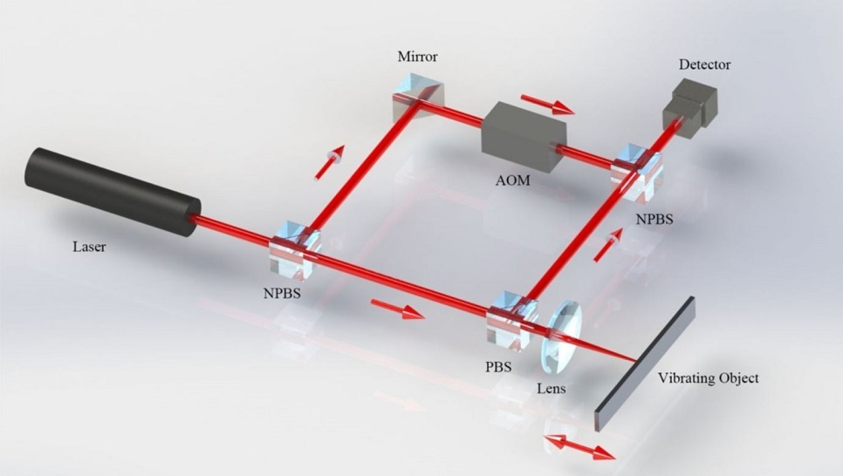
2.6 Literature Review - Laser Ultrasonic Method
Schematic diagram of the laser ultrasonic system
Sensing Unit
Control Unit
Laser Doppler Vibrometer
Receiver
Trigger
Trigger
Nd: Yag Laser
Galvanometer
Galvanometer
LDV
Excitation Unit
Sensing Unit
https://www.simtrum.com/WebShop/ProductList5.aspx?pid=1778.
Laser Doppler vibrometry for measuring vibration in ultrasonic transducers[J]. Ultrasonic Transducers, 2012, : 277-313.
Notes:
随后对信号进行接收，常用的激光检测仪器为LDV（Laser Doppler Vibrometer），激光多普勒测振仪，如右图所示。它利用激光多普勒效应与光外差干涉等原理对物体的振动进行测量。

Slide 20
2.6 Literature Review - Laser Ultrasonic Method
Schematic diagram of the laser ultrasonic system
Control Unit - Damage localization
Control Unit
Time reversal
Reconstruction signal
Original excitation signal
First
reception signal
Second excitation signal
Receiver
Time reversal
Trigger
Trigger
Nd: Yag Laser
Galvanometer
Galvanometer
LDV
Second Reception
Second excitation
First
excitation
First reception
Excitation Unit
Sensing Unit
High influence of environmental factors on the results, and poor reliability.
Time reversal active sensing for health monitoring of a composite plate[J]. Journal of Sound and Vibration, 2007, Vol. 302: 50-66.
Damage Imaging in Mesoscale Concrete Modeling Based on the Ultrasonic Time-Reversal Technique[J]. Acta Mechanica Solida Sinica, 2020, vol.33(1): 61-70.
Notes:
接收到信号后，随后将信号传递至上位机。由于损伤成像方法直观、精度高，拟采用损伤成像技术进行损伤表征。根据不同成像原理，有多种损伤成像技术，下面主要列举三种常用方法，首先是时间反转法。首先获得损伤散射的超声波信号,然后在时域内对信号进行反转,并用每个传感器元件作为激励源再发射，将二次接收信号与初始激发信号进行比较，对损伤进行检测。但是当测量噪声过大时，在第一次接收到的响应信号的噪声信息在反转之后重新激发，会对检测结果有较大的影响。

Slide 21
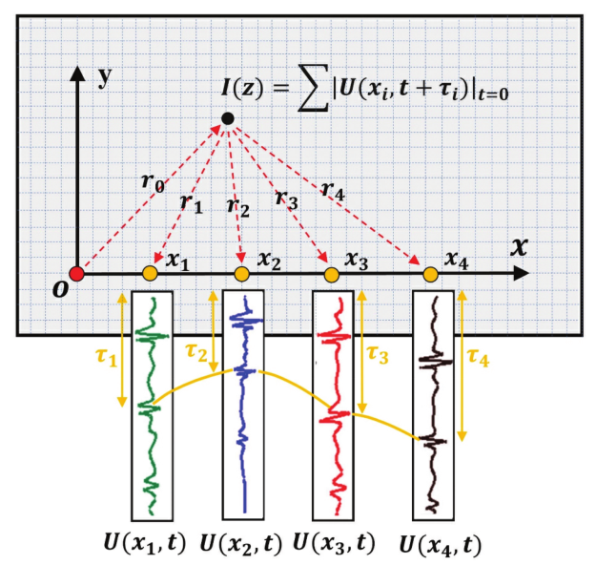
2.6 Literature Review - Laser Ultrasonic Method
Schematic diagram of the laser ultrasonic system
Control Unit - Damage localization
Control Unit
Phased Array Delay and Sum
Receiver
Trigger
Trigger
Nd: Yag Laser
Galvanometer
Galvanometer
LDV
Excitation Unit
Sensing Unit
High requirements for accuracy of time-of-flight.
Damage Imaging of Lamb Wave in Isotropic Plate Using Phased Array Delay and Sum Based on Frequency-domain Inverse Scattering Model[J], Nondestructive Testing & Evaluation, 2022, :1-16.
Detection, localization and characterization of damage in plates with an in situ array of spatially distributed ultrasonic sensors[J]. Smart Materials and Structures, 2008, Vol. 17(3): 035035.
Notes:
第二种方法是延时叠加法。如右图所示，红点为激发点，黄色点为接收点，通过计算不同感应位置的飞行时间对接收信号进行时间延迟，然后将同一时刻激发的所有感应信号所对应的延迟信号叠加在一起，通过评判损伤信号的幅值、能量等信息对损伤进行判定。但是该方法强烈依赖于飞行时间的准确性，对于混凝土这种各向异性材料来说，实施起来较为困难。

Slide 22
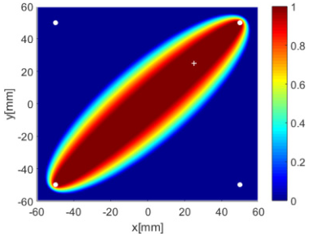
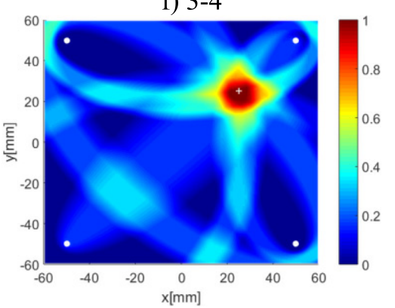
2.6 Literature Review - Laser Ultrasonic Method
Schematic diagram of the laser ultrasonic system
Control Unit - Damage localization
Control Unit
Probability-based damage imaging
Receiver
Sensing
Sensing
Trigger
Trigger
Single actuator-sensor path
Nd: Yag Laser
Galvanometer
Galvanometer
LDV
Excitation
Excitation Unit
Sensing Unit
All actuator-sensor paths
Schematic diagram
Diagnostic image
Poor accuracy of off-path damage localization.
Elliptical ring distribution probability-based damage imaging method for complex aircraft structures[J]. Journal of Vibroengineering, 2017, Vol.19(7) : 4936-4952
Research Progress in Damage Diagnostic Imaging of Aerospace Structures Based on Ultrasonic Guided Waves[J]. Aeronautical Manufacturing Technology, 2020, vol. 63 (18) : 24-43.
Notes:
第三种是概率成像法，该方法将待检测区域均匀地划分成多个网格（网格节点即像素点），网格中的每对传感器均形成一条激励—接收路径，每条路径对应一个椭圆，椭圆上的每个像素点都有一个相同的值，最后取经过该像素点的全部路径的概率之和来表示该处存在损伤的概率，则最大概率值即表示损伤最可能位置。该方法无需波在结构中传播的先验知识，如波的传播速度等，该方法对于不在路径上的损伤检测效果较差

Slide 23
2.6 Literature Review - Research Difficulties
Complex damage mechanism of offshore concrete structures
Chloride ion erosion, dry-wet cycle, wave hitting and many other factors.
A variety of damage types such as rebar corrosion, crack, voids, etc.
Difficulty in non-destructive testing technology application
Harsh environment for offshore concrete service.
Ultrasound attenuates quickly in concrete structures.
Difficult in signal processing due to low signal-to-noise ratio.
Complex propagation mechanism of ultrasonic waves in concrete.
In situ detection and characterization of alkali-silica reaction damage in concrete using contactless ultrasonic wavefield imaging[J]. Cement and Concrete Composites, 2022, : 104661.
Damage Imaging in Mesoscale Concrete Modeling Based on the Ultrasonic Time-Reversal Technique[J]. Acta Mechanica Solida Sinica, 2020, Vol. 33(1) : 61-70.
Time reversal damage localization in concrete based on two-dimensional meso-scale modeling[J]. Structural Health Monitoring, 2021, Vol. 20(1) : 188-201.
Durability deterioration of concrete under marine environment from material to structure: A critical review[J]. Journal of Building Engineering, 2021,Vol.35: 102074.
The effects of cyclic fluid pressure on time-dependent corrosion behaviour of offshore concrete caused by chloride ions[J]. Mechanics of Time-Dependent Materials, 2022.
Notes:
综上，目前海上混凝土损伤检测具有以下难点，首先，海上混凝土结构损伤机制复杂，因氯离子侵蚀、干湿循环等原因，结构会产生裂缝，空洞，等多种损伤，而目前损伤机制尚不明晰，其次，目前常用的无损检测技术应用困难，海洋结构服役环境恶劣，接触式检测安装困难且耗材大，而非接触检测技术中的激光超声技术使用超声波进行损伤检测，超声波在混凝土结构中，衰减快，信噪比低，传播机制复杂。

Slide 24
3 Plan
Research on crack damage detection in offshore concrete structures based on laser ultrasound
Theoretical study on ultrasonic detection of damaged concrete structures
Research on the multiple damage mechanisms
Analyze the propagation theory of ultrasonic waves in concrete structures
Determine the type of ultrasound to be excited
Offshore concrete ultrasonic detection technology innovation
Effectively excite the desired type of ultrasound
Optimize signal excitation and reception methods
Precisely extract the required signal components
Research on damage detection method for offshore concrete structures
Accurately identify the location of the damage
Precisely detect the degree of damage
Study the ultrasonic wave propagation characteristics during crack evolution
Design of remote damage detection system for offshore concrete structures
Design a remote monitoring solution
Build a remote monitoring system
Real-time visualization of damage to in-service structures
Notes:
为了解决以上问题，计划以基于激光超声的海上混凝土损伤检测方法为主题，开展以下研究，首先，针对海上混凝土结构开展损伤理论研究，然后，开展激光超声损伤检测技术创新研究，随后，开展混凝土结构损伤检测方法研究，最后，设计海上混凝土远程损伤检测系统，实现损伤的远程检测可视化。

Slide 25
3 Plan
Research Program
Theoretical study on ultrasonic detection of offshore concrete structures
Crack propagation law due to multiple damages
Research on the multiple damage mechanisms
Relationship between structural failure and different damages
Theoretical study on ultrasonic detection of offshore concrete structures
Propagation of ultrasonic waves in anisotropic materials
Theory of ultrasonic wave propagation in damaged concrete structures
Study on the attenuation of ultrasonic signals in concrete structures
Rayleigh wave-based damage study
Research on the type of ultrasound to be excited
Lamb wave-based damage study
Notes:
具体研究路线如下，第一，研究多损伤机制，确定混凝土失效形式，开展超声波在混凝土结构中的传播机理研究，基于此，明确超声波的激发类型。

Slide 26
3 Plan
Research Program
Theoretical study on ultrasonic detection of offshore concrete
Theoretical study on ultrasonic detection of offshore concrete structures
Excitation mechanism of laser ultrasound
Ultrasonic signal excitation research
Excitation method for specific ultrasonic signals
Offshore concrete structures ultrasonic detection technology innovation
Offshore concrete structures ultrasonic inspection technology innovation
Selection and optimization of excitation and reception method
Optimization of excitation and reception methods
Signal enhancement excitation method
Time-domain based noise reduction method
Research on signal processing methods
Frequency-domain based noise reduction method
Notes:
第二，研究激光超声激发方式，确定激发机制，准确激发所需超声波类型，优化激发方法，加强激发信号，并开展基于时频域的信号降噪研究，提高信号的信噪比，

Slide 27
3 Plan
Research Program
Theoretical study on ultrasonic detection of offshore concrete structures
Damage imaging method
Research on damage localization methods
Study of damage characterization indicators
Offshore concrete structures ultrasonic detection technology innovation
Research on damage detection method for offshore concrete structures
Research on crack propagation based on damage theory
Research on the crack propagation law
Crack propagation in relation to ultrasonic parameters
Research on damage detection method for offshore concrete structures
Multi-parameter characterization of crack propagation
Assessment of the degree of damage
Artificial intelligence based damage crack propagation research
Notes:
第三，开展损伤识别方法研究，准确判断损伤位置，基于损伤理论，研究裂纹演化过程，并结合人工智能，对结构损伤进行精准量化。

Slide 28
3 Plan
Research Program
Theoretical study on ultrasonic detection of offshore concrete structures
Feasibility design of remote monitoring system for in-service structures
Research on the remote monitoring solution
Reliability design of remote monitoring system for in-service structures
Offshore concrete structures ultrasonic detection technology innovation
Design of remote damage detection system for offshore concrete
Long-distance communication solutions
Design of remote monitoring system
Signal Acquisition Solutions
Research on damage detection method for offshore concrete structures
Design of remote damage detection system for offshore concrete structures
Remote evaluation algorithm research
Remote damage status visualization
Hardware & Software System Design
Notes:
最后，开展远程监测的方案设计，搭建远程监测系统，实现远程损伤可视化。

Slide 29
3 Plan
Research Progress Arrangement
Time | Theoretical Research | Details
2023.08-2024.01 | Research on ultrasonic detection of offshore concrete structures | Theoretical study of the propagation mechanism of ultrasonic waves in concrete structures for program demonstration
2024.02-2024.05 | Research on laser ultrasound excitation mechanism | Finite element analysis to determine the type of ultrasonic waves to be excited, the excitation, the reception details, etc.
2024.06-2024.12 | Research on damage localization theory | Determine the damage characterization index, propose the damage imaging method, and verify it by finite element and experiment.
2025.01-2025.06 | Research on crack propagation based on damage theory | Analysis and multi-covariate characterization of crack propagation under multi-damage mechanism.
2025.06-2025.12 | Remote damage detection system research | Design monitoring solutions and build hardware and software system platforms.
2026.01-2026.12 | Summarize my work and write the doctoral thesis

Slide 30
Thanks!

